Slide 1

Day Trips
Presented By:
Naveen Rana
(1178434)
Sunaiya
(1178466)

Slide 2

Contents
Company Profile
Introduction about Project
Statement about Problem
Objectives
Scope of the Project
Importance of Project
Why PHP?
Why MySQL

Slide 3
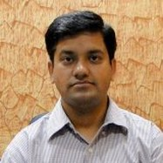
Introduction about Company
CS Group founded by Mr. Chhotu Sharma who is an amalgam of CS Infotech and CS Soft Solutions Pvt. Ltd.
He is recognized as “The Guru of Microsoft Technologies”.
Mrs. Shalini Sharma is Director of CS Soft Solutions Pvt. Ltd. and an adept teacher at CS Infotech.

Slide 4

CS Soft Solutions is a complete IT solutions providing company with huge clientele all over the world.
CS Soft Solutions Pvt. Ltd. was conceptualized in October 2009 by Mr. Chhotu Sharma and Mrs. Shalini Sharma.
CS Infotech is a pioneer institution which is engaged in providing computer education in Microsoft Technologies, to students as well as professional executives.
www.cssoftsolutions.com

Slide 5

Why Web Applications?
Can be used on multiple computers.
Operating system independent.
Don’t require any installation.
Generated data can be shared easily.
Inexpensive or free.

Slide 6
Why PHP?
Used for web development.
To create dynamic websites.
Php run on different operating system such as window, Linux, Unix and so on.
Php is free to download from the official Php resource: http://www.php.net.
Easy to learn and runs efficiently and swiftly on any compatible web server.
Php supports a wide range of databases.
Php is compatible with almost all servers used today(Apache , IIS, etc.).

Slide 7
MYSQL
MySQL was originally founded and developed in Sweden by two Swedes and a Finn: David Ax mark, Allan Larsson and Michael "Monty" Widenius, who had worked together since the 1980's.
Open source database software.
Superior speed.
Reliability.
Ease of use.
MySQL has become the preferred choice for Web, Web 2.0, SaaS, ISV, Telecom companies .

Slide 8
Three-Tier Web Application Development
In web application development, we use three-tier architecture refers to separating the application process into three specific layers.
What the user sees via a web browser is called the presentation tier and is content served from a web server.
The middle tier performs the business logic processing that occurs, for example, when a user submits a form.
The back end consists of the data tier which handles the database processing and access to the data.

Slide 9
Cont..
1. Presentation Tier: It is the portion the user sees when they open a web page in the browser. It is what is presented to the user on the client side within their web browser. Languages used in this layer are php, HTML, CSS and JavaScript.
2. Business Logic or Application Tier: In php, this is where you define your classes and source code. HTML or JavaScript is not used in this layer. You typically define your classes, functions, sub procedures, properties,etc. 3. Data Access Tier: Data Access layer is where you define your typed datasets and table adapters. It is where you define your queries or stored procedures.

Slide 10
Benefits
Improves performance and scalability.
If web page needs an update or redesign, all of this may be handled by altering the CSS and HTML, without affecting the business or data logic.
Any of the three tiers may be Replaced or upgraded individually without affecting the other tiers.
For instance, if you change the database on the back end, it wouldn't affect the presentation or business logic tiers, other than changing the database connection.

Slide 11
Introduction about the Project (Day Trips)
DayTrips is a site that lets you find and share the best day trips in most interesting cities around the world.“Frightened by the thought of exhaustive week-long itineraries”DayTrips is a way to provide an easy way to take vacations one day at a time. The aim of the site is double: on the one hand, turning your own city exploration into a more exciting experience; on the other, providing access to an “ever-expanding library of trips in places that life may take you.“ Once you choose your destination, you will find all the information necessary to get away for a day! Then check out DayTrips to find and share the day trips you never knew you could take in cities just like this

Slide 12
Objectives
Providing user friendly interface.
Easy access of data.
Easy maintenance.
Maintaining data consistency.
Providing better performance.
Increasing the Efficiency through automation.
Security of data..
User can access his/her documents from anywhere.
Adequate validation checks for data entry

Slide 13
Modules
The modules for project are:
User Account Maintenance
Admin
User
\

Slide 14
Importance of the Day Trips
The Project Day Trips will be beneficial in the following way:
From User’s Point of view:
Easy to Use
Easily available anywhere using internet
Saves time and money
Accurate and efficiently available information
Less efforts

Slide 15
Introduction about Technology used
PHP is a server-side scripting language designed for web development but also used as a general-purpose programming language.
Originally created by Rasmus Lerdorf in 1995, the reference implementation of PHP is now produced by The PHP Group.
PHP commands can be embedded directly into an HTML source document rather than calling an external file to process data.
PHP is free software released under the PHP License, which is incompatible with the GNU General Public License (GPL) due to restrictions on the usage of the term PHP.

Slide 16
Cont..
To save time and money powering their high-volume Web sites, critical business systems, and packaged software — including industry leaders such as Yahoo!, Alcatel-Lucent, Google, Nokia, YouTube, Wikipedia, and Booking.com.
MySQL is a key part of LAMP (Linux, Apache, MySQL, PHP / Perl / Python).

Slide 17
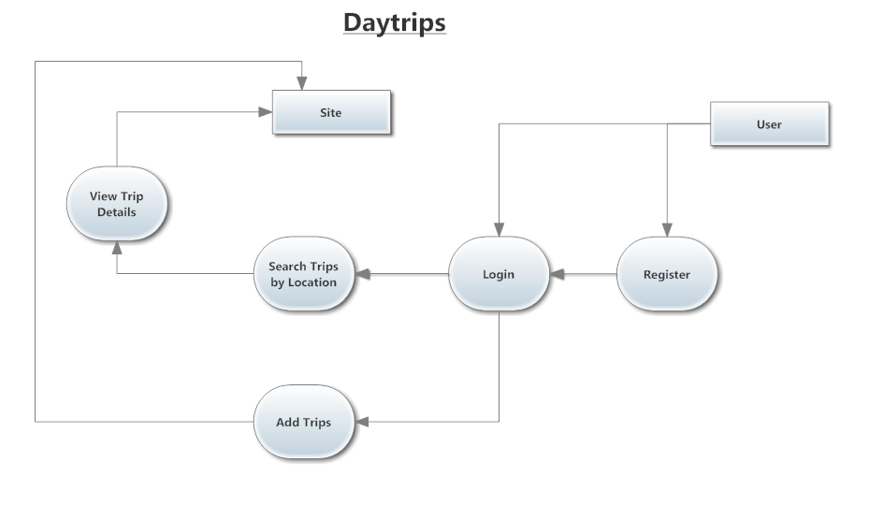
DFD of Day Trips

Slide 18
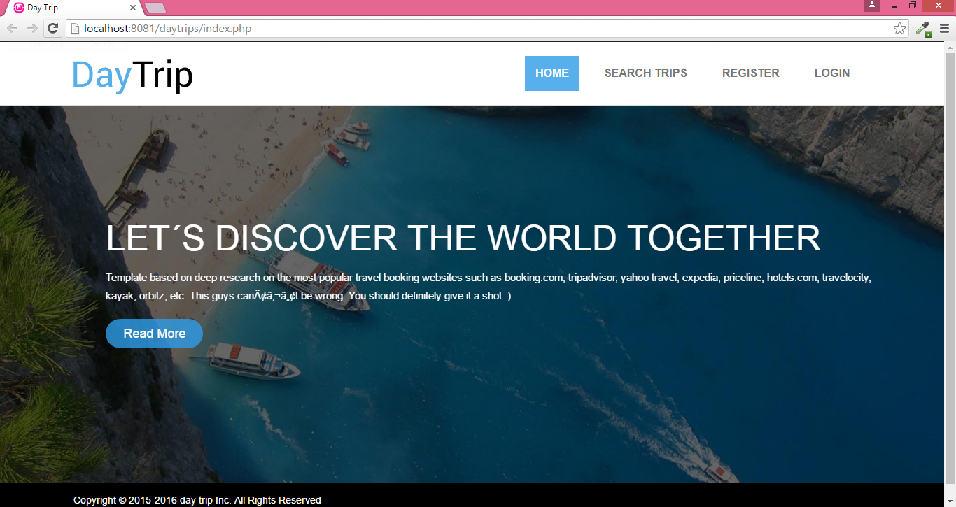

Slide 19
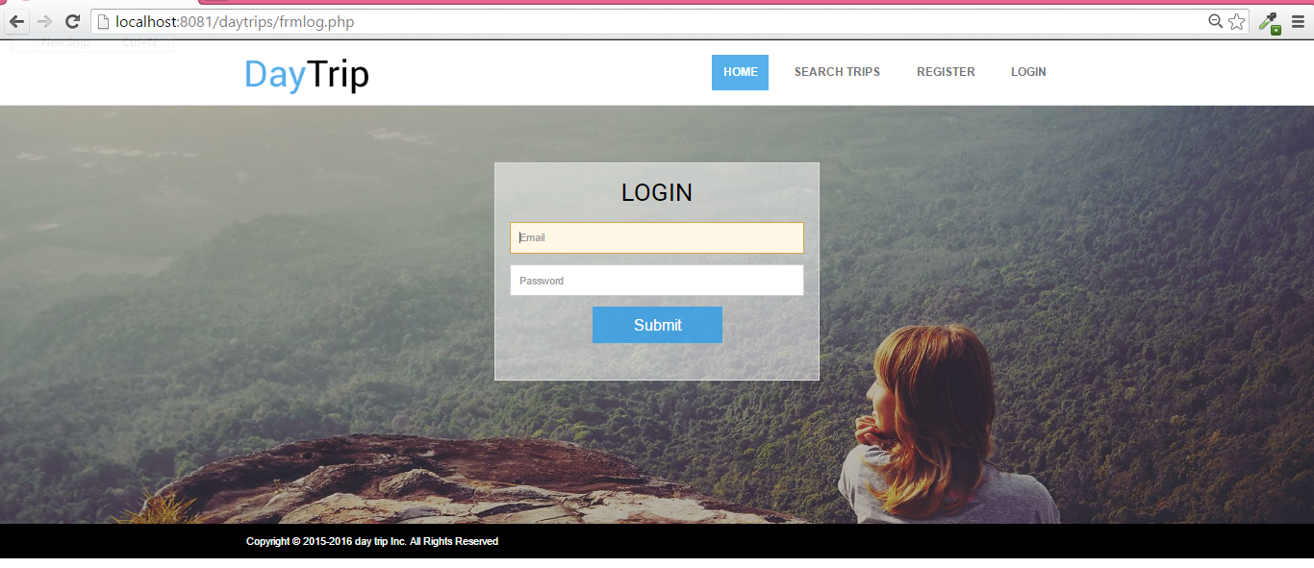

Slide 20
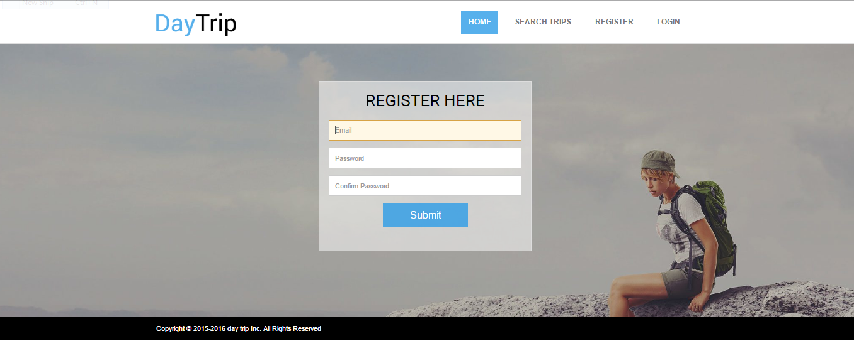

Slide 21
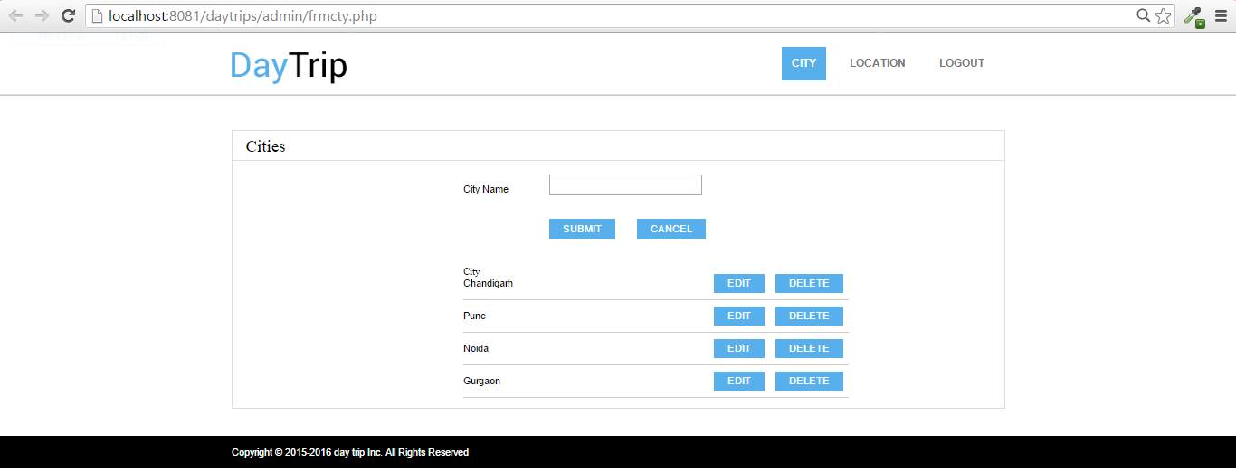

Slide 22
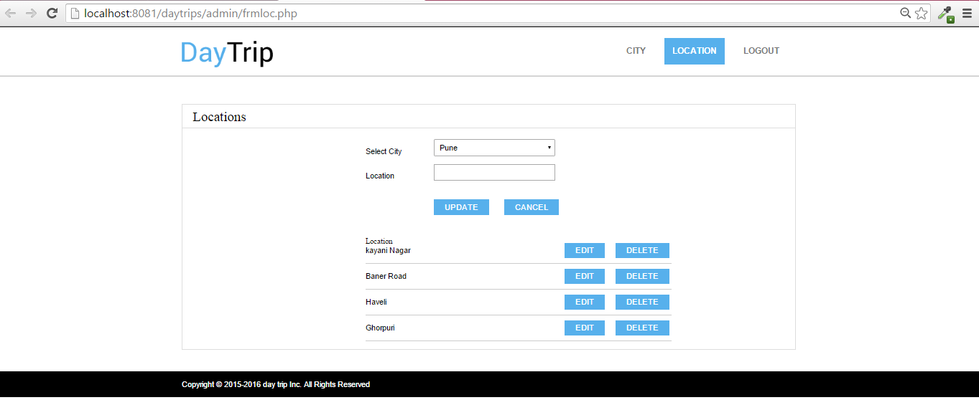

Slide 23
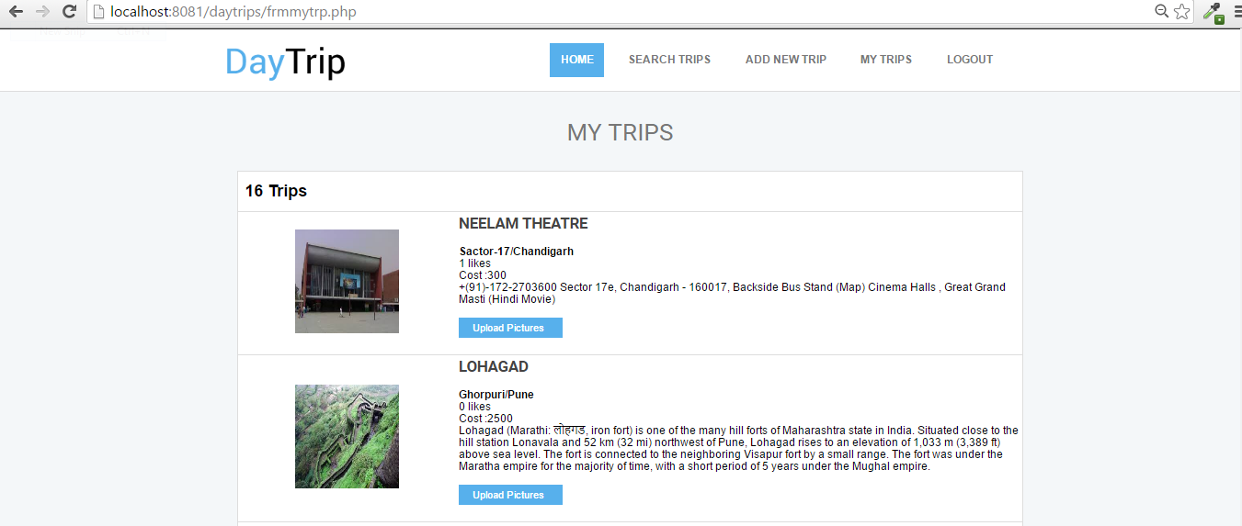

Slide 24
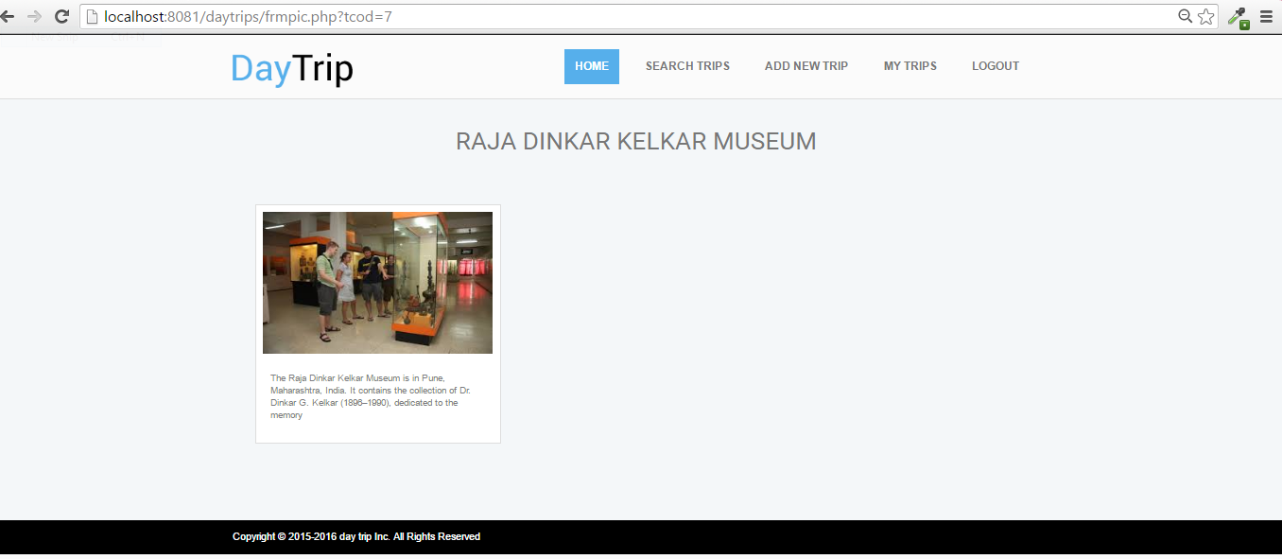

Slide 25
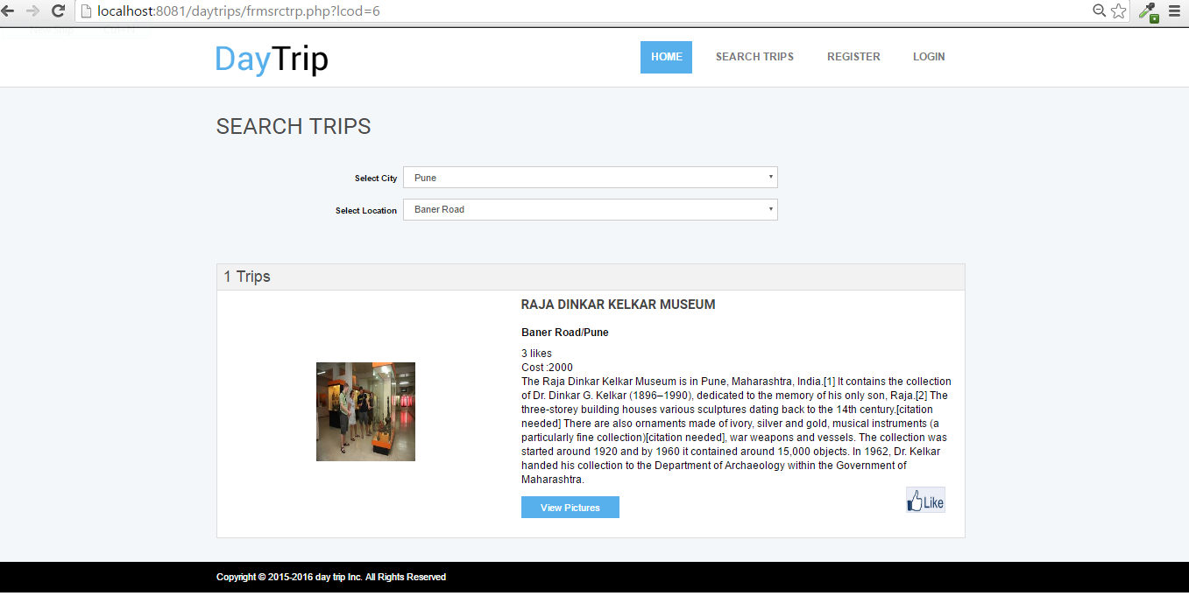

Slide 26


Slide 27
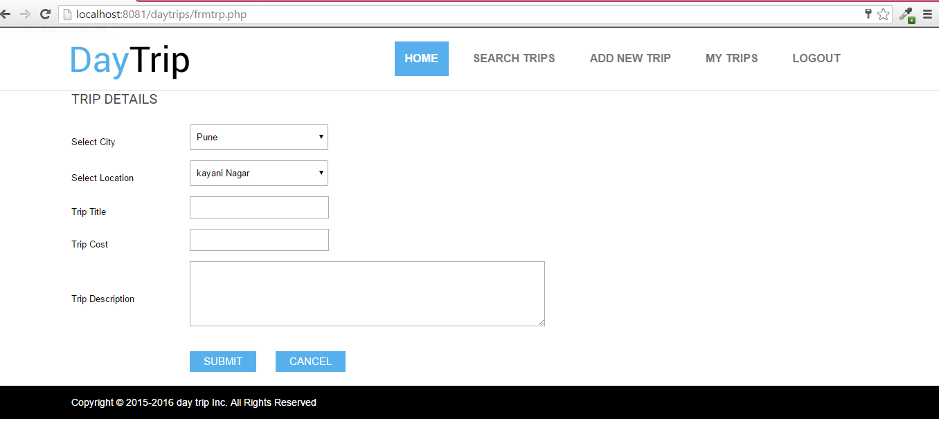

Slide 28
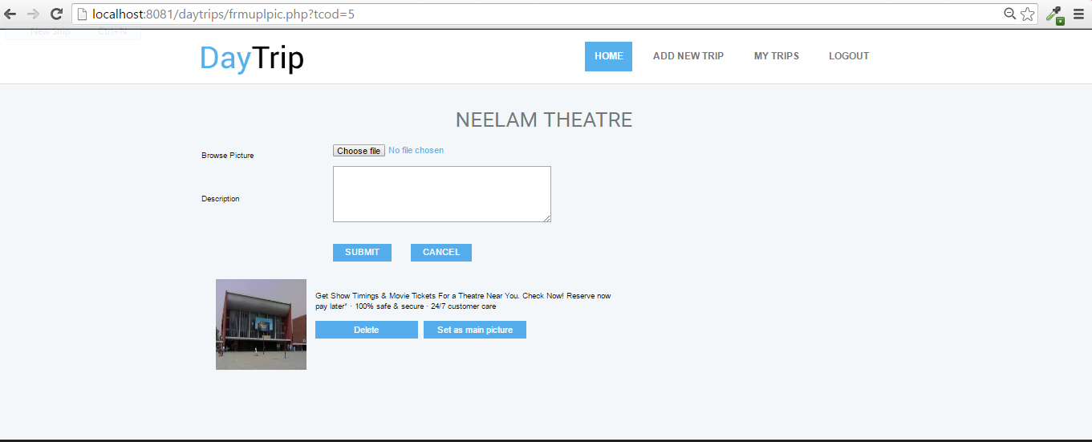

Slide 29
THANKS

